Slide 1
Signed Numbers

Slide 2
Signed Numbers
Signed-magnitude form
1’s and 2’s complement form
Decimal value of signed numbers

Slide 3
Signed Numbers
Signed-magnitude form
  The sign bit is the left-most bit in a signed binary number
  A 0 sign bit indicates a positive magnitude
  A 1 sign bit indicates a negative magnitude

Slide 4
Signed Numbers
1’s complement form
  A negative value is the 1’s complement of the corresponding positive value
2’s complement form
  A negative value is the 2’s complement of the corresponding positive value

Slide 5
Arithmetic Operations with Signed Numbers
Addition
Subtraction
Multiplication
Division

Slide 6
Arithmetic Operations with Signed Numbers
Addition of Signed Numbers
The parts of an addition function are:
  Addend
  Augend
  Sum
Numbers are always added two at a time.

Slide 7
Arithmetic Operations with Signed Numbers
Four conditions for adding numbers:
Both numbers are positive.
A positive number that is larger than a negative number.
A negative number that is larger than a positive number.
Both numbers are negative.

Slide 8
Arithmetic Operations with Signed Numbers
Signs for Addition
When both numbers are positive, the sum is positive.
When the larger number is positive and the smaller is negative, the sum is positive. The carry is discarded.

Slide 9
Arithmetic Operations with Signed Numbers
Signs for Addition
When the larger number is negative and the smaller is positive, the sum is negative (2’s complement form).
When both numbers are negative, the sum is negative (2’s complement form). The carry bit is discarded.

Slide 10
Arithmetic Operations with Signed Numbers
Subtraction of Signed Numbers
The parts of a subtraction function are:
  Subtrahend
  Minuend
  Difference
Subtraction is addition with the sign of the subtrahend changed.

Slide 11
Arithmetic Operations with Signed Numbers
Subtraction
The sign of a positive or negative binary number is changed by taking its 2’s complement
To subtract two signed numbers, take the 2’s complement of the subtrahend and add. Discard any final carry bit.

Slide 12
Arithmetic Operations with Signed Numbers
Multiplication of Signed Numbers
The parts of a multiplication function are:
  Multiplicand
  Multiplier
  Product
Multiplication is equivalent to adding a number to itself a number of times equal to the multiplier.

Slide 13
Arithmetic Operations with Signed Numbers
There are two methods for multiplication:
Direct addition
Partial products
The method of partial products is the most commonly used.

Slide 14
Arithmetic Operations with Signed Numbers
Multiplication of Signed Numbers
If the signs are the same, the product is positive.
If the signs are different, the product is negative.

Slide 15
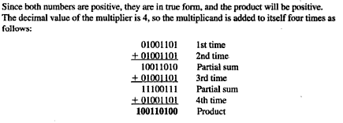

Slide 16
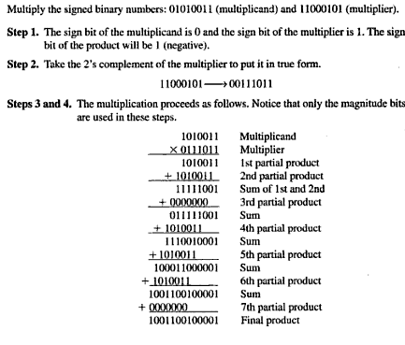

Slide 17


Slide 18
Arithmetic Operations with Signed Numbers
Division of Signed Numbers
The parts of a division operation are:
  Dividend
  Divisor
  Quotient
Division is equivalent to subtracting the divisor from the dividend a number of times equal to the quotient.

Slide 19
Arithmetic Operations with Signed Numbers
Division of Signed Numbers
If the signs are the same, the quotient is positive.
If the signs are different, the quotient is negative.

Slide 20
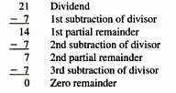
Dividing 21 by 7

Slide 21
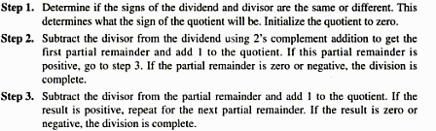
Basic steps in a division process are as follows

Slide 22
